Slide 1
The computer system hardware
Unit 2

Slide 2
CPU (central processing unit) or processor or Microprocessor
Central Processing Unit (CPU) or the processor is also often called the brain of computer. CPU consists of Arithmetic Logic Unit (ALU) and Control Unit (CU). In addition, CPU also has a set of registers which are temporary storage areas for holding data, and instructions.
ALU performs the arithmetic and logic operations on the data that is made available to it. CU is responsible for organizing the processing of data and instructions. CU controls and coordinates the activity of the other units of computer. CPU uses the registers to store the data, instructions during processing.

Slide 3
For processing, CPU gets data and instructions from the memory. It interprets the program instructions and performs the arithmetic and logic operations required for the processing of data. Then, it sends the processed data or result to the memory.
CPU also acts as an administrator and is responsible for supervising operations of other parts of the computer.
The CPU is fabricated as a single Integrated Circuit (IC) chip, and is also known as the microprocessor. The microprocessor is plugged into the motherboard of the computer

Slide 4
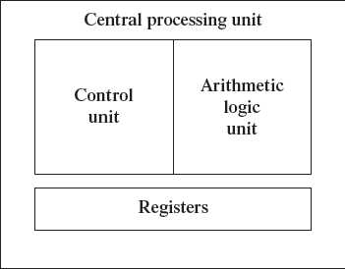
Fig. CPU

Slide 5
Arithmetic Logic Unit
ALU consists of two units—arithmetic unit and logic unit.
The arithmetic unit performs arithmetic operations on the data that is made available to it.
Some of the arithmetic operations supported by the arithmetic unit are—addition, subtraction, multiplication and division.
The logic unit of ALU is responsible for performing logic operations. Logic unit performs comparisons of numbers, letters and special characters. Logic operations include testing for greater than, less than or equal to condition.
ALU performs arithmetic and logic operations, and uses registers to hold the data that is being processed.

Slide 6
Registers
Registers are high-speed storage areas within the CPU, but have the least storage capacity.
Registers store data, instructions, addresses and intermediate results of processing. Registers are often referred to as the CPU’s working memory.
The data and instructions that require processing must be brought in the registers of CPU before they can be processed. For example, if two numbers are to be added, both numbers are brought in the registers, added and the result is also placed in a register.

Slide 7
Control Unit
The control unit of a computer does not do any actual processing of data. It organizes the processing of data and instructions. It acts as a supervisor and, controls and coordinates the activity of the other units of computer.
CU coordinates the input and output devices of a computer. It directs the computer to carry out stored program instructions by communicating with the ALU and the registers.
It also instructs the ALU to perform the arithmetic or logic operations.
CU tells when to fetch the data and instructions, what to do, where to store the results, the sequencing of events during processing etc.
CU also holds the CPU’s Instruction Set, which is a list of all operations that the CPU can perform.

Slide 8
MEMORY UNIT
The memory unit consists of cache memory and primary memory. Primary memory or main memory of the computer is used to store the data and instructions during execution of the instructions. Random Access Memory (RAM) and Read Only Memory (ROM) are the primary memory.
In addition to the main memory, there is another kind of storage device known as the secondary memory. Secondary memory is non-volatile and is used for permanent storage of data and programs. A program or data that has to be executed is brought into the RAM from the secondary memory.

Slide 9
Cache Memory
The time taken to move the data between RAM and CPU registers is large. This affects the speed of processing of computer, and results in decreasing the performance of CPU.
Cache memory is a very high speed memory placed in between RAM and CPU. Cache memory increases the speed of processing.
Cache memory stores the data that is used more often, temporarily, and makes them available to CPU at a fast rate. During processing, CPU first checks cache for the required data. If data is not found in cache, then it looks in the RAM for data.
Cache memory is very expensive, so it is smaller in size. Generally, computers have cache memory of sizes 256 KB to 2 MB.

Slide 10
Primary Memory
Primary memory is the main memory of computer. It is used to store data and instructions during the processing of data. Primary memory is semiconductor memory.
Primary memory is of two kinds—Random Access Memory (RAM) and Read Only Memory (ROM).
RAM is volatile. It stores data when the computer is on. The information stored in RAM gets erased when the computer is turned off. RAM provides temporary storage for data and instructions.
ROM is non-volatile memory, but is a read only memory. The storage in ROM is permanent in nature, and is used for storing standard processing programs that permanently reside in the computer. ROM comes programmed by the manufacturer.
RAM stores data and instructions during the execution of instructions. The data and instructions that require processing are brought into the RAM from the storage devices like hard disk.

Slide 11
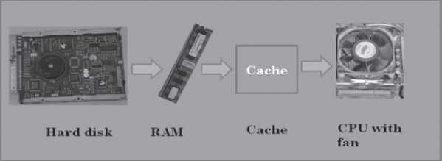
Figure : Interaction of CPU with memory

Slide 12
Secondary Memory
The secondary memory stores data and instructions permanently. The information can be stored in secondary memory for a long time (years), and is generally permanent in nature unless erased by the user. It is a non-volatile memory.
It provides back-up storage for data and instructions. Hard disk drive, floppy drive and optical disk drives are some examples of storage devices.
The data and instructions that are currently not being used by CPU, but may be required later for processing, are stored in secondary memory.
Secondary memory has a high storage capacity than the primary memory.
Secondary memory is also cheaper than the primary memory.
It takes longer time to access the data and instructions stored in secondary memory than in primary memory.

Slide 13

INSTRUCTION FORMAT
An instruction is designed to perform a task. An instruction is divided into groups called fields. The common fields of an instruction are— Operation (op) code and Operand code.
The operation code represents action that the processor must execute. The operand code defines the parameters of the action.
Figure: Instruction format

Slide 14

INSTRUCTION SET
A processor has a set of instructions that it understands, called as instruction set. The instruction set is embedded in the processor , which determines the machine language for the processor.
Fig: Instruction set

Slide 15
INSTRUCTION CYCLE
CPU executes each instruction in a series of steps, called instruction cycle.
A instruction cycle involves four steps —
Fetching : The processor fetches the instruction from the memory. The fetched instruction is placed in the Instruction Register. Program Counter Register holds the address of next instruction to be fetched and is incremented after each fetch.
Decoding :The instruction that is fetched is broken down into parts or decoded. The instruction is translated into commands so that they correspond to those in the CPU’s instruction set.
Executing: The decoded instruction or the command is executed.
Storing: CPU writes back the results of execution, to the computer’s memory.

Slide 16
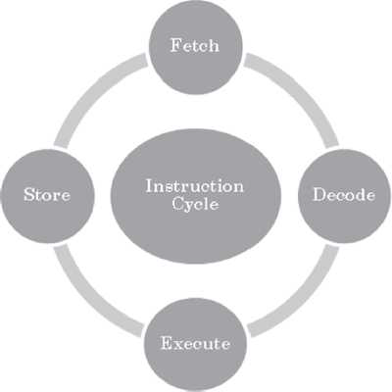
Figure: Instruction cycle

Slide 17
MICROPROCESSOR
On the basis of the instruction set, microprocessors are classified as—
Complex Instruction Set Computer (CISC)
Reduced Instruction Set Computer (RISC).

Slide 18
Complex Instruction Set Computer (CISC):
CISC architecture hardwires the processor with complex instructions.
CISC has a large instruction set that includes simple and fast instructions for performing basic tasks, as well as complex instructions that correspond to statements in the high level language.
An increased number of instructions results in a much more complex processor, requiring millions of transistors.
Instructions are of variable lengths, using 8, 16 or 32 bits for storage.
AMD(Advanced Micro Devices) and Cyrix are based on CISC

Slide 19
Reduced Instruction Set Computer (RISC)
RISC has simple, single-cycle instructions, which performs only basic instructions. RISC architecture does not have hardwired advanced functions.
RISC has fewer instructions and requires fewer transistors, which results in the reduced manufacturing cost of processor.
The instruction size is fixed (32 bits).
The instructions, simple in nature, are executed in just one clock cycle, which speeds up the program execution when compared to CISC processors.
Apple Mac G3 and PowerPC are based on RISC

Slide 20
INTERCONNECTING THE UNITS OF A COMPUTER
Bus: Bus is a set of electronic signal pathways that allows information and signals to travel between components inside or outside of a computer. The different components of computer, i.e., CPU, I/O unit, and memory unit are connected with each other by a bus. The data, instructions and the signals are carried between the different components via a bus.
A computer bus can be divided into two types—Internal Bus and External Bus.
The Internal Bus connects components inside the motherboard like, CPU and system memory. It is also called the System Bus.

Slide 21
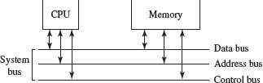
Fig: internal bus

Slide 22
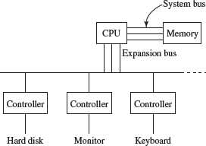
The External Bus connects the different external devices, peripherals, expansion slots, I/O ports and drive connections to the rest of computer. The external bus allows various devices to be attached to the computer. It allows for the expansion of computer’s capabilities. It is generally slower than the system bus. It is also referred to as the Expansion Bus.
Figure: External bus

Slide 23
Types of system bus
Data bus
Address bus
Control bus.

Slide 24
Data Bus
Data Bus transfers data between the CPU and memory. The bus width of a data bus affects the speed of computer. The size of data bus defines the size of the processor. A processor can be 8, 16, 32 or 64-bit processor. An 8–bit processor has 8 wire data bus to carry 1 byte of data. In a 16–bit processor, 16–wire bus can carry 16 bits of data, i.e., transfer 2 bytes, etc.

Slide 25
Address Bus:-
Address Bus connects CPU and RAM with set of wires similar to data bus.
Control Bus:-
Control Bus specifies whether data is to be read or written to the memory, etc.

Slide 26
Types of expansion bus
Data bus
Address bus
Control bus.

Slide 27
Data Bus :
Data Bus is used to transfer data between I/O devices and CPU.
Address Bus :
Address Bus carries the addresses of different I/O devices to be accessed like the hard disk, CD ROM, etc.
Control Bus :
Control Bus is used to carry read/write commands, status of I/O devices, etc.

Slide 28
INSIDE A COMPUTER CABINET
Motherboard
USB Ports
Expansion Slots
Memory Chips
Storage Devices
Processor

Slide 29
******THE END******

